Slide 1



KARL: Fast Kernel Aggregation Queries
Authors: (Edison) Tsz Nam Chan^{1,2}, Man Lung Yiu² and Leong Hou U³
1: The University of Hong Kong
2: Hong Kong Polytechnic University
3: University of Macau
(Presented by: Edison)
[1] T. N. Chan, M. L. Yiu and L. H. U “KARL: Fast Kernel Aggregation Queries” ICDE2019 (To appear)

Slide 2
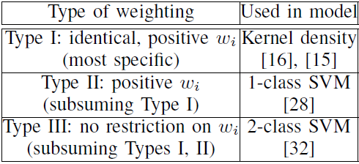
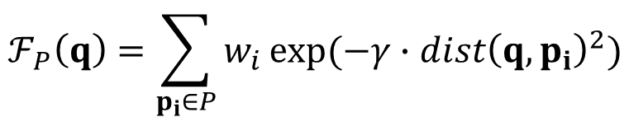
Kernel Aggregation Function and Statistical/Machine learning Models
Kernel aggregation function:
$$ℱ_{P}\left(q\right)=\sum_{p_{i}∈P}{w_{i}}exp⁡(−γ∙{dist\left(q,p_{i}\right)}^{2})$$

Slide 3
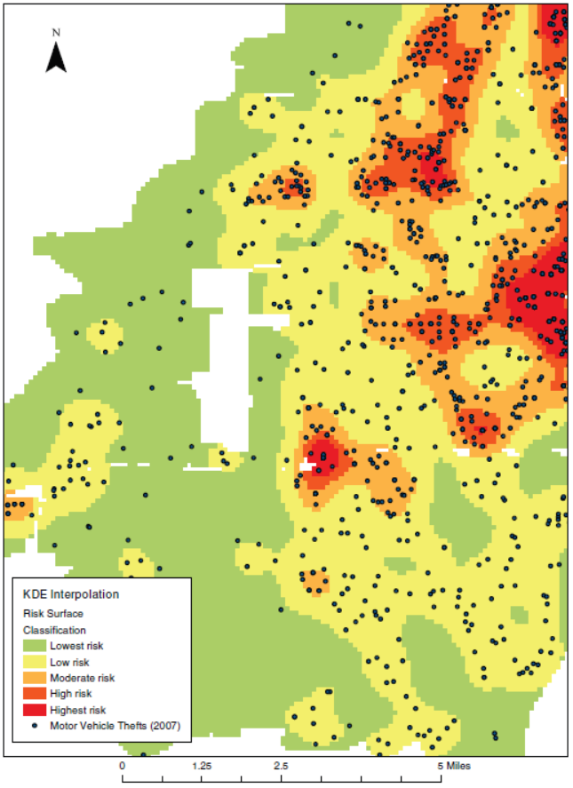
Kernel Density Estimation/ Classification
Black dots (Crimes)
Aggravated assault
Robbery
Commercial burglary
motor vehicle theft
Regions:
Crime rates prediction
T. Hart and P. Zandbergen “Kernel density estimation and hotspot mapping Examining the influence of interpolation method, grid cell size, and bandwidth on crime forecasting”, International Journal of Police Strategies and Management 2014

Slide 4
Kernel Support Vector Machine Classification
User 5
Classify
User 4
Anomaly
Class
Signal
Server
Normal
Class
User 1
User 2
User 3
A. L. Buczak and E. Guven. A survey of data mining and machine learning methods for cyber security intrusion detection. IEEE Communications Surveys and Tutorials, 2016.

Slide 5
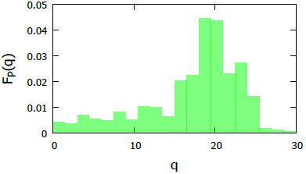
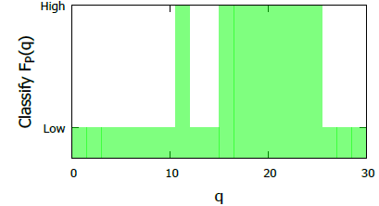
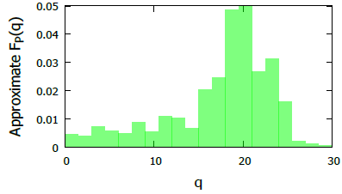
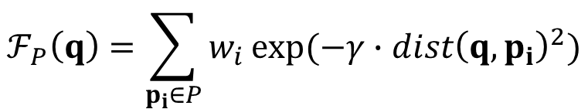
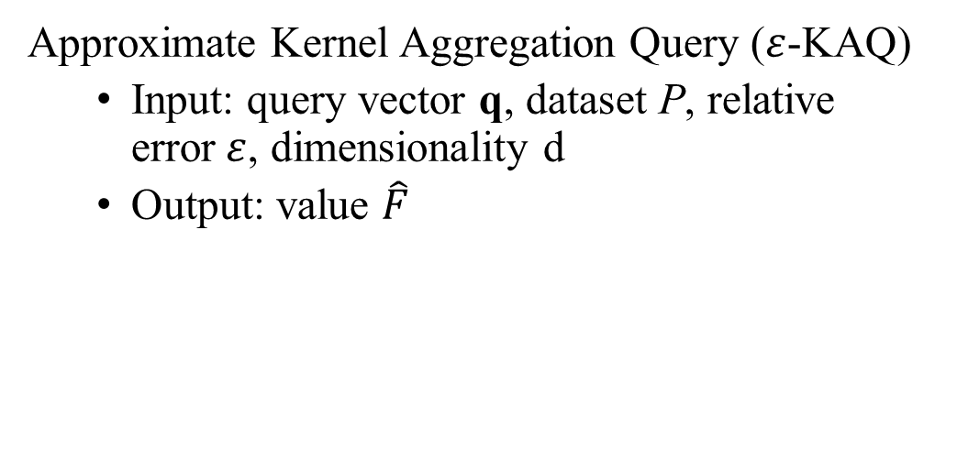
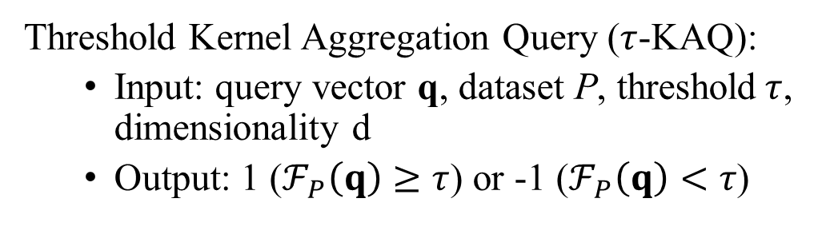

Kernel Aggregation Queries (KAQ)
$$ℱ_{P}\left(q\right)=\sum_{p_{i}∈P}{w_{i}}exp⁡(−γ{∙dist\left(q,p_{i}\right)}^{2})$$
Kernel aggregation function:
Threshold Kernel Aggregation Query ($τ$-KAQ):
Input: query vector q, dataset P, threshold$τ$, dimensionality d
Output: 1 ($ℱ_{P}\left(q\right)≥τ$) or -1 ($ℱ_{P}\left(q\right)<τ$)
Approximate Kernel Aggregation Query ($ε$-KAQ)
Input: query vector q, dataset P, relative error$ε$, dimensionality d
Output: value $\hat{F}$
where: $(1−ε)ℱ_{P}\left(q\right)≤\hat{F}≤(1+ε)ℱ_{P}\left(q\right)$
KAQ
τ-KAQ, τ=0.01
ε-KAQ, ε=0.2

Slide 6
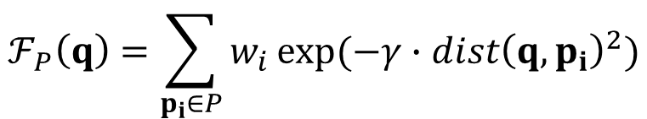
Kernel Aggregation Queries are slow!
Le et al. “Despite their successes, what makes kernel methods difficult to use in many large scale problems is the fact that computing the decision function is typically expensive, especially at prediction time.” [1]
Hsieh et al. “However, computing the decision function for the new test samples is typically expensive which limits the applicability of kernel methods to real-world applications.” [2]
Jung et al. “..., it has the disadvantage of requiring relatively large computations in the testing phase” [3]
$$ℱ_{P}\left(q\right)=\sum_{p_{i}∈P}{w_{i}}exp⁡(−γ{∙dist\left(q,p_{i}\right)}^{2})$$
O(|P| × d) time
[1] Quoc V. Le, Tamas Sarlos, and Alexander J. Smola. “Fastfood- computing hilbert space expansions in loglinear time.” In ICML2013
[2] Cho-Jui Hsieh, Si Si, and Inderjit S. Dhillon. “Fast prediction for large-scale kernel machines.” In NIPS2014.
[3] Ho Gi Jung and Gahyun Kim. "Support vector number reduction: Survey and experimental evaluations." IEEE Trans. Intelligent Transportation Systems 2014.

Slide 7
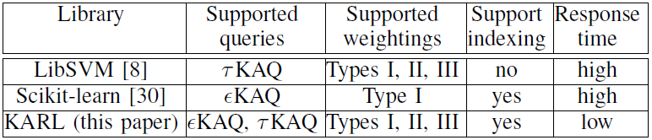
Our contribution: KARL
Kernel Aggregation Rapid Library (KARL) [1]
2.5-738x speed up over state-of-the-art in different datasets
The Fastest library in online prediction phase
[1] https://github.com/edisonchan2013928/KARL-Fast-Kernel-Aggregation-Queries

Slide 8
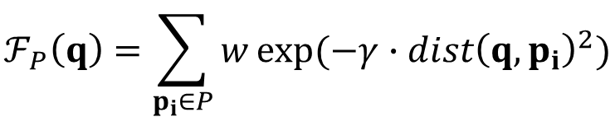
How to speed up?
UB(q)
$$ℱ_{P}\left(q\right)=\sum_{p_{i}∈P}{w}exp⁡(−γ∙{dist\left(q,p_{i}\right)}^{2})$$
q is in class +1
LB(q)
+1
τ
O(|P| × d) time
UB(q)
-1
q is in class -1
$$LB\left(q\right)≤ℱ_{P}\left(q\right)≤UB(q)$$
LB(q)

Slide 9
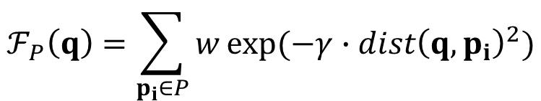
Existing Work: Bounding Functions
Example: |P|=3
R
$$ℱ_{P}\left(q\right)=\sum_{p_{i}∈P}{w}exp⁡(−γ∙{dist\left(q,p_{i}\right)}^{2})$$
maxdist(q,R)
$${LB}_{R}\left(q\right)=w∙R.count∙exp⁡(−γ{∙maxdist\left(q,R\right)}^{2})$$
q
mindist(q,R)
$${UB}_{R}\left(q\right)=w∙R.count∙exp⁡(−γ{∙mindist\left(q,R\right)}^{2})$$
O(d) time
[1] E. Gan and P. Bailis. "Scalable kernel density classification via threshold based pruning" SIGMOD2017
[2] A. G. Gray, A. W. Moore “Nonparametric Density Estimation: Toward Computational Tractability” SDM03

Slide 10
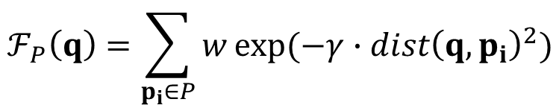
Weakness of Existing Bound Functions
$$ℱ_{P}\left(q\right)=\sum_{p_{i}∈P}{w}exp⁡(−γ{∙dist\left(q,p_{i}\right)}^{2})$$
$${LB}_{R}\left(q\right)=w∙R.count∙exp⁡(−γ{∙maxdist\left(q,R\right)}^{2})$$
x_{i}
x_{max}
x_{min}
x₁
x₂
Too loose
x₃
x_{max}
function
exp(–x)
existing bound:
exp(-x_{max})
1. Can we develop the tighter lower bound functions?

Slide 11
Our Work: Tangent Bound
$$ℱ_{P}\left(q\right)=\sum_{p_{i}∈P}{w}exp⁡(−γ{∙dist\left(q,p_{i}\right)}^{2})$$
$${LB}_{R}\left(q\right)=w∙R.count∙exp⁡(−γ{∙maxdist\left(q,R\right)}^{2})$$
x_{i}
x_{max}
x_{min}
the tangent line (at x_{max}):
E^{L}(x) = m_{l} x + c_{l}
x₁
x₂
x₃
x_{max}
function
exp(–x)
existing bound:
exp(-x_{max})
2. How to compute these tight bounds quickly?

Slide 12
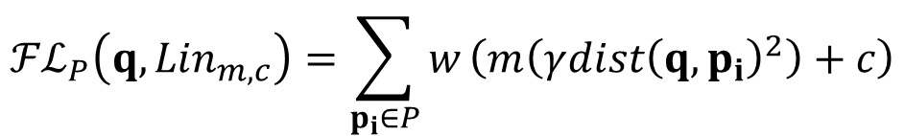
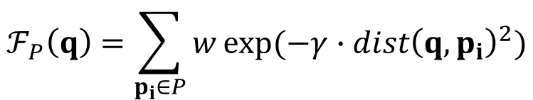
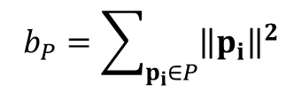
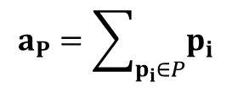
O(d)-time Tighter Linear Bound
$$ℱ_{P}\left(q\right)=\sum_{p_{i}∈P}{w}exp⁡(−γ{∙dist\left(q,p_{i}\right)}^{2})$$
Tightness
Exact
x_{i}
Linear bound of $ℱ_{P}\left(q\right)$:
$${ℱℒ}_{P}\left(q,{Lin}_{m,c}\right)=\sum_{p_{i}∈P}{w}\left(m\left(γ{dist\left(q,p_{i}\right)}^{2}\right)+c\right)$$
Ours
x_{i}
Existing bounds
$${ℱℒ}_{P}\left(q,{Lin}_{m,c}\right)=wmγ\left(\left|P\right|{\left\|q\right\|}^{2}−2q∙a_{P}+b_{P}\right)+wc|P|$$
Time
O(d)
O(|P|d)
O(d)
O(d)
where
$$a_{P}=\sum_{p_{i}∈P}{p_{i}}$$
and
$$b_{P}=\sum_{p_{i}∈P}{{\left\|p_{i}\right\|}^{2}}$$

Slide 13
Advanced Version: Optimized Tangent Bounds
x_{min}
x_{min}
the tangent line (at x_{max}):
E^{L}(x) = m_{l} x + c_{l}
x₁
x₁
Still loose
x₂
x₂
x₃
x_{max}
function
exp(–x)
x₃
x_{max}
function
exp(–x)
existing bound:
exp(-x_{max})
optimized tangent line (at t):
E^{L}(x)=m_{l} x + c_{l}
Finding the optimized tangent line is also in O(d) time.
[1] T. N. Chan, M. L. Yiu and L. H. U “KARL: Fast Kernel Aggregation Queries” ICDE2019 (To appear)

Slide 14
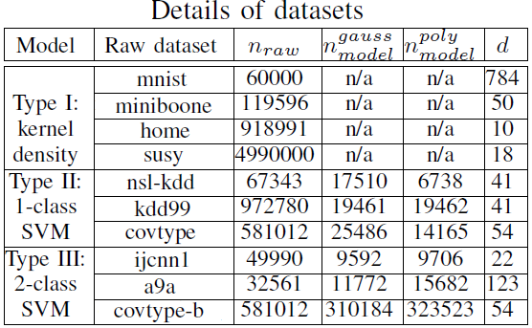
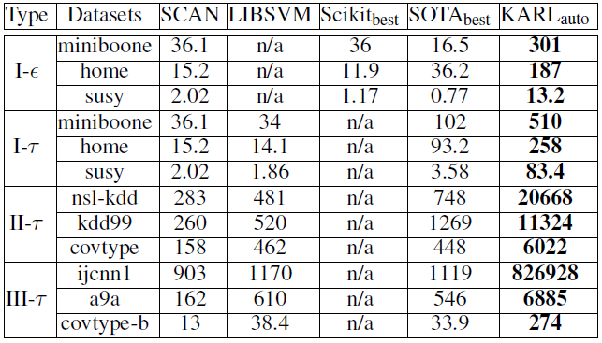
Experimental Results
Methods: SCAN (baseline), LIBSVM [1], Scikit_{best} [2], SOTA_{best} [3] and KARL_{auto} [4]
Throughput (Queries/sec)
[1] C.-C. Chang and C.-J. Lin "LIBSVM: A library for support vector machines" ACM TIST2011
[2] F. Pedregosa et al. "Scikit-learn: Machine learning in python" JMLR2011
[3] E. Gan and P. Bailis. "Scalable kernel density classification via threshold based pruning" SIGMOD2017
[4] T. N. Chan, M. L. Yiu and L. H. U “KARL: Fast Kernel Aggregation Queries” ICDE2019 (To appear)

Slide 15
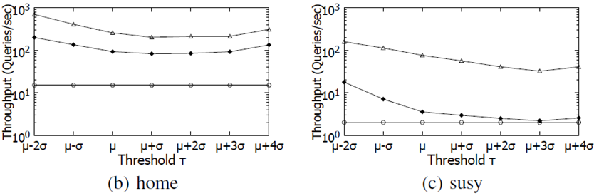
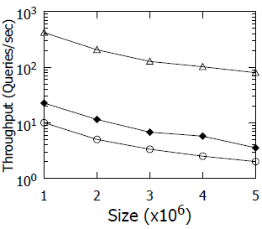
Scalability Experiments (in Type I-τ)
Vary seven thresholds
Vary data size in dataset susy
[1] E. Gan and P. Bailis. "Scalable kernel density classification via threshold based pruning" SIGMOD2017
[2] T. N. Chan, M. L. Yiu and L. H. U “KARL: Fast Kernel Aggregation Queries” ICDE2019 (To appear)

Slide 16
Conclusion and Future Work
What we have done:
Develop tighter lower and upper bound functions with same time complexity
Support a wide range of models (in prediction stage)
Kernel Density Estimation
Kernel Density Classification
One Class SVM
Two Class SVM
Achieve higher throughput than the state-of-the-art by 2.5-738x times
Future Work:
Integrate the implementation into the library (Onging)
Support different types of kernel functions (Ongoing)
Support interesting applications, e.g., Kernel Density Visualization (Ongoing)

